Slide 1
Notes:
Arrival
Show this slide while participants are arriving.
Start and introduction to the topic
Welcome the participants.
Organizational points, e.g., name tags.
Facilitator introduces him/herself (e.g., name, pronoun, vocation and contact with the topic “ADM and Discrimination“).
These workshop documents are one of the results of the project: AutoCheck – a Guide about Automated Decision-Making Systems for Equality Bodies. The project was funded by the Federal Anti-Discrimination Agency between February 2021 and July 2022 and implemented by AlgorithmWatch. Parts of the project included:
Researching case studies of discrimination through ADM systems in Germany.
Interviewing anti-discrimination counselors and experts.
Based on the research and interviews: the guidebook “Automated Decision-Making Systems and Discrimination” and this workshop were developed.

Slide 2
Notes:
Start and introduction to the topic
This quote is from an interview with an anti-discrimination expert. Facilitator reads the quote.
Today‘s workshop will look at three key points:
What are automated decision-making systems?
How can they lead to discrimination?
What does that mean for anti-discrimination work?
Target group: employees at anti-discrimination counseling centers.
Goal of the workshop: By building up competencies in this increasingly important field, we hope to enable you to better recognize and assess risks to support those affected by discrimination.
Important Note: The focus is on risks of discrimination. There are useful applications of ADM systems, but we are going to look at the risks.

Slide 3
Notes:
Start and introduction to the topic
Facilitator quickly goes through the agenda.
3

Slide 4
Notes:
Introduction and expectations
We will do a short round of introductions. Please introduce yourself:
Name, pronoun, organization. What question did you bring today (if several, choose one)? What do you like to do? (Something about you that you would like to share in this round: hobby, leisure activity, personal)?
You have a maximum of 90 seconds per person to introduce yourself (it usually takes less). To make sure everyone sticks to the time, I set a timer that rings after 90 seconds.
Facilitator sets the timer to 90 seconds for each person.
Facilitator writes down on a flip chart the questions that the participants brought to the training. The facilitator can come back to the questions during the day or check if all the questions were answered before the feedback.
4

Slide 5
Notes:
Introduction to the topic
To get started with the topic and to get an impression of the group, we do a line-up exercise.
On a scale of 1-10: How often do you encounter artificial intelligence and automated decision-making systems? How many points of contact do you have with the topic? 10 - very often/daily; 1 - not at all.
Facilitator: Show clearly, where in the room the scale runs, i.e., where 1 is and where 10 is. Give the participants a short time to position themselves at the right point. Then ask 2-3 people why they are standing at that point.
5

Slide 6
Notes:
Introduction to the topic
Next question:
On a scale of 1-10: How do you rate your prior knowledge of AI/ADM systems and discrimination risks? 1 means you have never dealt with this before, 10 that you are well acquainted with the topic.
Facilitator: Show clearly, where in the room the scale runs, i.e., where 1 is and where 10 is. Give the participants a short time to position themselves at the right point. Then ask 2-3 people why they are standing at that point.
6

Slide 7
Notes:
Introduction to the topic
The third and last question: This is about your opinion, there is no right or wrong answer to the question: Do you rather see opportunities or risks in AI/ADM systems?
Facilitator: Show clearly, where in the room the participants should place themselves: Left – Opportunity; Right – Risk. Give the participants a short time to position themselves at the right point. Then ask 2-3 people why they are standing at that point.
Thank you for participating in the line-up exercise.
Everyone sits down again.
7

Slide 8
Notes:
Key terms – Introduction
The line-up exercise gave us an impression of the knowledge or points of contact with the topic "automated decision-making systems and discrimination" that are present in the group.
In the title of the training, we have already heard the term "automated decision-making systems"; the term artificial intelligence has also been mentioned before. We will now talk about the basic terms for this workshop: Algorithms, Artificial Intelligence, and Automated Decision-Making Systems.
We will go through the terms one by one and define them together.
The facilitator goes through the terms one by one:
Takes the respective moderation card and pins it up.
Asks the participants if anyone knows the term and it’s meaning.
Writes down the answers on moderation cards and pins them up in a structured way.
Pins up the printed definition and shares it with the group.
8

Slide 9
Notes:
Key terms – Exercise
Now that we have defined the terms, let’s make this a bit more practical: Divide into groups of two. You will receive a total of 5 examples from me: 1-2 everyday examples per term. Please assign these examples to the terms. Feel free to experiment a little. You have 5-10 minutes, then we will discuss the results together.
Facilitator goes around and checks if there are any questions. After 5 minutes, check if participants need more time.
9

Slide 10
Notes:
Key terms – Discussion
Come back to the circle of chairs. Review the terms algorithm, ADM system, and AI one at a time:
Repeat definition.
Ask groups what everyday example they have assigned to the term and why? Discuss and debate in plenary.
If questions come up during the group work, they can be clarified here.
For the term algorithm: There are two everyday examples here because there are different forms of algorithms that have an impact on how ADM systems work. Rule-based vs. learning algorithms. Facilitator reads out definition, and collectively assign to examples.
Address when it fits:
When you assigned the examples, you noticed that there is a lot of overlap. That's because the terms overlap: Artificial intelligence is used in everyday language for very different applications, all of which fit under ADM systems. ADM systems are based on algorithms, and here too there is a strong overlap in the application.
10

Slide 11
Notes:
15-minute break.
11

Slide 12
Notes:
ADM fields of application
In the last exercise, we discussed basic terms and touched on first applications in the everyday examples. Now we will focus on the fields of application of ADM systems. It is about the context in which the use of ADM systems is likely to occur in order for you to recognize them more easily when you are counseling.
What other fields of application for ADM systems can you think of? Let's brainstorm together now.
Facilitator reads out the questions on slide 12; collects participants' answers on the flip chart and clusters them by area (e.g., housing market, financial sector, or similar).
Design transition to slide 13 depending on participants' answers.
12

Slide 13
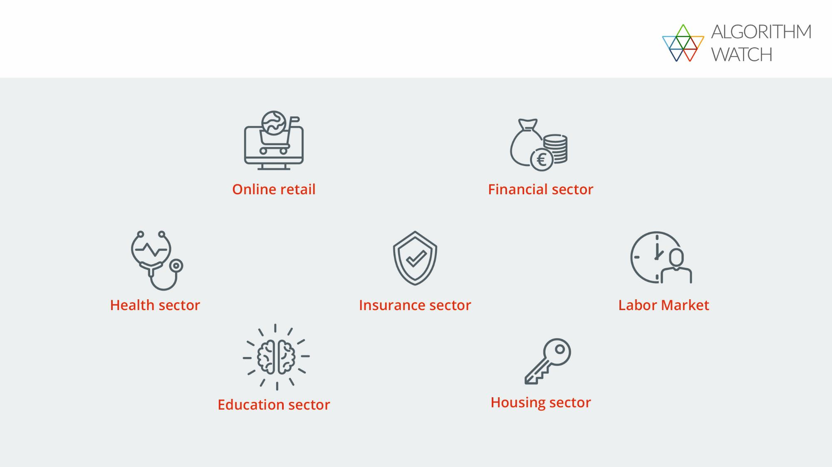
Notes:
Figure fields of application
These fields of application are based on the publication (p. 14-15).
The facilitator goes through the fields of application individually and gives 1-2 examples each:
Insurance sector: insurance policies taken out online (liability) or online forms.
Financial sector: Chabot interactions (can be based on learning algorithms and change), automated verification of submitted documents.
Online retail: payment options offered (sometimes changes after entering a zip code), data-based targeted advertising.
Housing sector: tenancies (credit checks), pre-sorting of applications (when there are a large number of apartments or applications).
Health sector: pattern recognition in diagnostics, e.g., early detection of melanoma.
Education sector: Automated assignment of daycare places for children.
Labor Market: application procedure (language analysis, video analysis).
Address the overlaps and differences from the previous brainstorming session.
Due to a lack of transparency and information rights in Germany, we do not know with certainty where ADM systems are currently deployed. Indications of use are: Statistical calculations have been carried out for a long time, data are available (e.g., credit checks). Often something has to be sorted, categorized, predicted or efficiency has to be increased.
13

Slide 14
Notes:
Causes
We have now gained some insight into where ADM systems might be used. Now, we will talk about how discrimination can occur in the development and use of ADM systems, i.e., what the causes of discriminatory outcomes are.
When we talk about causes of discrimination by ADM systems, it is helpful to think of them as socio-technical systems, that is, to consider the social components as well as the technical ones. There is a strong overlap here with your work. The specific social context in which ADM systems are created influences them, and this includes structural discrimination. Socio-technical (i.e., ADM) systems reflect assumptions, values, perspectives, and biases of the people who develop and use them.
14

Slide 15
Notes:
Causes
Facilitator reads the quote out loud.
People make decisions at different points in the development and application of ADM systems - in the worst cases, these decisions lead to (unwanted) discrimination. Now, we will look at some of the choices: The selection of data, goals, models and in the application.
15

Slide 16
Notes:
Causes
Data are numerical values, which were collected by measurements, statistical surveys, observations, and the like. Data are not neutral: they reflect the (power) structures of society because they can never represent reality one-to-one. People decide which data are collected and how they are used, and thus also what can be discovered through the data. Data was collected in the past and thus reflects it. If data is used to predict the future, for example, this assumes that the future is similar to the past.
If suitable: Data are especially relevant for learning algorithms.
People decide, for example, the following:
Read figure boxes 1-5 and connect them with case study c) (Publication, p. 8), e.g.:
Box 1 – Representativeness of data: If, in the learning phase, the algorithm was trained with data consisting predominantly of images of faces with light skin tones, then these were overrepresented and, in turn, faces with dark skin tones were under-represented. Consequently, ADM systems work badly, or not at all, for the under-represented group.
Box 5: Data must be prepared for use by learning algorithms (annotation). Humans often annotate data e.g., by marking data that contains the correct result for a task. In case study c) for the development of the face recognition software, for example, the images representing faces had to be marked in the used image dataset.
16

Slide 17
Notes:
Causes
People decide on the goal of using an ADM system.
First, they identify a problem that needs to be solved, e.g., how to select the most suitable person for a job from a pool of applicants. The solution could be a recruiting process performed by humans. Alternatively, an ADM system might be seen as a viable way of solving the problem. The next step is to decide which objective the system itself should pursue. For example, to reduce costs, increase efficiency, etc. However, the objectives could also include the reduction of bias in a decision-making process or to prevent discrimination.
Read figure boxes 1-5 and connect them with case study d) (Publication, p. 9), e.g.:
Box 1 – Purpose: People who are more likely to be interested and click on the ads, should see the ads.
Box 4 – Goal: the goal could have been to maximize the number of clicks on job ads. If Facebook had, for example, defined the goal, to support gender equity in society, the ad distribution would probably have been different.
17

Slide 18
Notes:
Causes
A mathematical model describes a segment of reality; reality is reduced in complexity. By simplifying a situation, it can be transformed into a mathematical problem. In credit checks, for example, mathematical models are used to calculate the probability that a person will repay a loan. People decide which criteria are relevant for this and bring their own assumptions and ideas into it.
Read figure boxes 1-4 and connect them with case study a) (Publication, p. 6), e.g.:
Box 1+2 – Assumptions and translation: If the model was the cause here, the assumption that gender and age have an impact on a person's ability to pay would have been included in the model. Alternatively, creditworthiness could be determined by whether credit card bills are paid monthly.
Box 4 – Quality standards: It could be scientifically verified in how many cases the predictions - based on a model that a person will not repay the loan - are actually true.
18

Slide 19
Notes:
Causes
The decision to use an ADM system is based on assumptions about the possibilities and capabilities of those systems. People tend to overestimate ADM systems and rely on their recommendations. In scientific literature this tendency is called “automation bias”. This tendency increases with time pressure.
Read figure boxes 1-5 and connect the examples:
Box 1 – purpose: Is the ADM system used for what it was designed for? For example, a system for the pre-selection of applications is used for the hiring decision.
Box 2 – Training: If HR managers know what possibilities and weaknesses are available in the software to support application processes, they can better classify the results/suggestions and use them better for decision-making.
Box 4 + 5 – Contradiction: a software system is used to enable case workers to make more decisions in less time. If a person questions the system's recommendations and decision-making processes are drawn out, this could have negative consequences for the person and lead to them not objecting.
19

Slide 20
Notes:
Causes – Understanding
Imagine that an ADM system selects your new supervisor: The goal is to select the most competent person possible.
What criteria do you think the ADM system should include (e.g., degree, work experience)?
What criteria does the ADM system use to identify the most competent person for the job?
What data do you need to gather for this? What information about the person do you need to do this?
Please work on this task in groups of three and document the results on moderation cards. You will have 15 minutes to do the task, then we will come together as a group and discuss the results.
20

Slide 21
Notes:
Causes – Discussion
Each group in turn presents the results and pins the moderation cards on the pinboard. To stimulate discussion, the facilitator can ask questions such as:
What criteria did you agree on?
How do you find out if a person meets these criteria?
What did you discuss in your group?
Are you satisfied with your results?
What was easy? What was difficult?
In the thought experiment, you dealt with a fictional example. In reality, there are attempts to solve similar tasks with ADM systems: Detecting fraud in social welfare, detecting child endangerment in police work. Here, the application of ADM systems can have drastic effects on people.
21

Slide 22
Notes:
Solutions
The question of possible solutions is an important one. In the context of this workshop, however, we can only touch on it: How can discrimination by ADM systems be avoided?
Transparency & comprehensibility: We need more transparency where systems are used. We also need more traceability on which assumptions and criteria these systems are based and also how the quality of the systems is ensured or checked.
Accountability: It is often not clear who is responsible and liable to prosecution if discrimination is caused by an ADM system. In many cases, this could be the software company that developed the ADM system or the company that applies the ADM system.
Public discussion: We need a broader societal discussion about where we want to use ADM systems and where we would rather not.
22

Slide 23
Notes:
60-minute lunch beak.
23

Slide 24
Notes:
Arriving
The participants return from the lunch break.
A quick look at the agenda: what did we do in the morning? What comes next? Clarify open questions from the morning.
24

Slide 25
Notes:
Recognize
Now that we have discussed what ADM systems are, where they are used, and how discrimination can occur, the next step is to identify ADM systems in anti-discrimination counseling.
To do this, I will give you a checklist with questions to use in counseling. (Hand out checklist.) We'll go through that checklist now before you apply it.
Introduce checklist and go through it. Clarify open questions so that participants can use the checklist in the next exercise.
25

Slide 26
Notes:
Recognize – Exercise
Explain the exercise:
In groups of three, you will simulate a counseling situation in which you apply the checklist. For this purpose, there will be one affected person, one counselor and one observer in each group.
The affected person will receive a short description of the situation from me. Please read it through and take a few moments to put yourself in the situation:
Who are you? What has happened? Why are you visiting the anti-discrimination counseling center?
I ask the counselor to put him/herself in the role of a counselor. Please look at the "Recognition" checklist again and think about where and how you could apply the questions in a counseling session.
Please sit down in a group of three and act out the counseling case. The observer should sit to the side, listen carefully and take notes for the debriefing: What seems important to you? What is talked about?
You have 10 minutes. The goal is to first understand the case, not how to handle it - that happens later. Then there is an evaluation in groups of three.
Facilitator goes around and checks if there are any questions and monitors how the exercise is going. Remind the groups of the time.
26

Slide 27
Notes:
Recognize – Exercise
After about 10 minutes, the facilitator hands out moderation cards with the questions on slide 27 to the small groups and asks:
Step out of your role. Please describe how the situation was for you: How did you feel? What went well? What would you have liked to have done differently?
Observer: What was your impression? What did you observe?
You have 15 minutes for this debrief. Then we will get together in plenary and talk about it together.
Facilitator goes around and checks to see if there are any questions and to monitor how it is going. Remind the groups of the time and come back to the plenary after 15 minutes.
27

Slide 28
Notes:
Recognize – Discussion
Now let's discuss together how the exercise was and what you discussed in your small groups. I will take notes.
Facilitator writes down keywords and open questions and pins them to the pinboard.
What happened in the small groups? How did the counseling go?
What did you discuss in the debrief?
What does this imply for your anti-discrimination work?
Conclusion: it is challenging to identify ADM systems in counseling cases. For one thing, there is a lack of transparency about where ADM systems are used. On the other hand, there is often a lack of comparison - one sits alone in front of the computer and does not know what is displayed or offered to others. This exercise and the checklist are intended to raise awareness and lead you to think about ADM systems and to be aware of the idea that an ADM system could also be involved in a counseling case.
28

Slide 29
Notes:
15-minute break.
29

Slide 30
Notes:
Handling
An immediate question when you suspect the influence of an ADM system in an anti-discrimination counseling case is: What are the options for dealing with it?
You receive a checklist on this topic with information that you can use for this. (Hand out checklist.) We'll go through that checklist now before you apply it.
Introduce the checklist and go through it. Clarify open questions so that participants can use the checklist in the next exercise.
In any case, point out that there are hardly any known cases in Germany at present. Accordingly, there is a lack of empirical knowledge and many questions are still open.
30

Slide 31
Notes:
Handling – Exercise
We now want to apply this checklist as well. To do this, please go back to your groups of three and put yourself back into your roles.
Counselor: Based on your usual procedure in anti-discrimination counseling, please consider with the affected person how you could/would deal with the situation. Please use the checklist for this.
You have 15 minutes to talk about how to handle the situation. Afterwards, there will be another debriefing in your small group.
31

Slide 32
Notes:
Handling – Exercise
After about 15 minutes, the facilitator hands out moderation cards with the questions on slide 32 to the small groups and asks them:
Please step out of your role and discuss what the situation was like:
What options do you see for dealing with the situation?
How can common interventions be used?
What role do ADM systems play in this?
What open questions do you have?
You have 15 minutes for this debrief. Please document your approaches and discussion points on moderation cards. Afterwards, we will come together in plenary and talk about it together.
Facilitator goes around and checks if there are any questions and monitors how it is going. Remind the groups of the time and to come back to the plenary after 15 minutes.
32

Slide 33
Notes:
Handling – Discussion
We will now discuss together how the exercise went and what you discussed in your small groups. You have taken notes; I ask each group to briefly present the notes and pin them to the pinboard.
Facilitator assists and takes notes as necessary.
If conversations and discussions do not arise on their own, the facilitator can ask the following questions:
What steps did you consider to deal with the case?
What did the person affected want?
What was the debriefing about?
What challenges do you see related to this topic area?
What open questions do you have?
Facilitator summarizes the most important discussion points.
33

Slide 34
Notes:
Outlook
The questions about how to handle discrimination through ADM systems cannot be ultimately resolved at this time.
34

Slide 35
Notes:
Outlook
As stated at the beginning, the widespread use of automated systems is a relatively new phenomenon, many legal questions are currently pending (see Box “Artificial Intelligence Act” and “Digital Services Act“).
There is, for example, an ongoing discussion about the role that data or consumer protection could have in addition to, or in interaction with, the General Equal Treatment Act. What this might look like in concrete terms has not yet been clarified.
The Federal Anti-Discrimination Agency has commissioned the legal opinion “The General Equal Treatment Act and the Protection against Discrimination by Algorithmic Decision Systems“ (tender title). The expert opinion is being prepared by Prof. Dr. iur. Indra Spiecker gen. Döhmann and Prof. Dr. Emanuel V. Towfigh.
Transfer to counseling work: The difficult and, at the same time, decisive aspect of trainings: The application to everyday work. That's why it's good to be reminded of the topic and this training every now and then.
That's why I'm giving you a postcard today that shows an illustration from the publication. You can hang this postcard at your workplace, for example, and remind yourself of the workshop whenever you see it.
35

Slide 36
Notes:
Networking
Precisely because this is such a new topic, empirical knowledge is still lacking and the framework conditions are changing, it is all the more important that you exchange information with colleagues on this topic and - should you have a case in counseling - talk about it with each other.
We recommend on the one hand: If you should have a case that involves ADM systems, include it in the documentation. Networking meetings with other anti-discrimination counseling centers would then be a good opportunity to bundle and discuss these cases.
36

Slide 37
Notes:
Networking
Furthermore, we would like to support you in networking among yourselves on this topic. For this, I ask you to take your calendar out and set a date in about 2 months.
The meeting does not have to be long, 30-45 minutes is enough - it can be face-to-face or online, it can be a coffee break or lunch.
On the one hand, this meeting should remind you of the contents of this workshop. On the other hand, you could talk about the following:
What did you take away from the workshop?
What are the implications for your work?
General exchange on the topic
37

Slide 38
Notes:
Feedback
We are almost at the end of the workshop. I would like to take a look at the questions that you brought and we collected this morning.
Facilitator goes through the questions from the morning and clarifies if they have been answered or not, then transition to feedback.
I would very much appreciate your feedback. Please write your answers to the following questions on moderation cards and pin them to the pinboard accordingly:
I liked ...
This could have gone better ....
I missed ...
38

Slide 39
Notes:
Conclusion
Thank you very much for your feedback. Now I'd like to wrap up the workshop with a final round: How do you leave this workshop?
The participants and the facilitator answer the question one after the other.
39

Slide 40
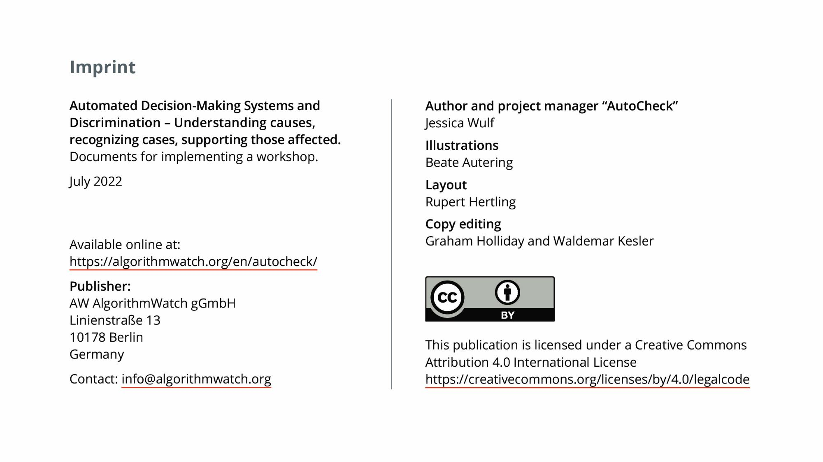
Notes:
40

